Slide 1
2022 California Economic
& Housing Market Forecast
Greater San Diego Association of REALTORS®
January 13, 2022
Jordan G. Levine
VP & Chief Economist
California Association of REALTORS®

Slide 2
Big picture as we transition from pandemic to endemic
01
02
Lots to be optimistic about
Conflicting or co-exitisting?
Economy improving despite COVID flare
Housing remains the economic bright spot
Further signs of market normalization, but…
Acceleration of longstanding structural change
03
04
Many headwinds brewing
What does it all mean?
Biggest challenge remains supply: new + existing
+ rates, affordability, sustainability, & industry stuff
Time to get serious about housing supply
Important for REALTORS® AND economy at large

Slide 3
Let’s Talk About
That Economic Tide

Slide 4
COVID is the wildcard that we didn’t predict well last year…

Slide 5
California continues to make economic progress
~575K
~825K
2.7m

Slide 6
A tale of two economies: best AND worst of times

Slide 7
Broad-based recovery—especially leisure areas

Slide 8
2021 was the best year for home sales in a decade

Slide 9
Initial Signs of
Market Normalizing

Slide 10
Top end of market starting to moderate
SERIES: Percent Change in Sales
SOURCE: CALIFORNIA ASSOCIATION OF REALTORS®

Slide 11
Core markets punching above their weight

Slide 12
Supply Remains
THE Challenge

Slide 13
Listings following seasonal pattern and leveling off

Slide 14
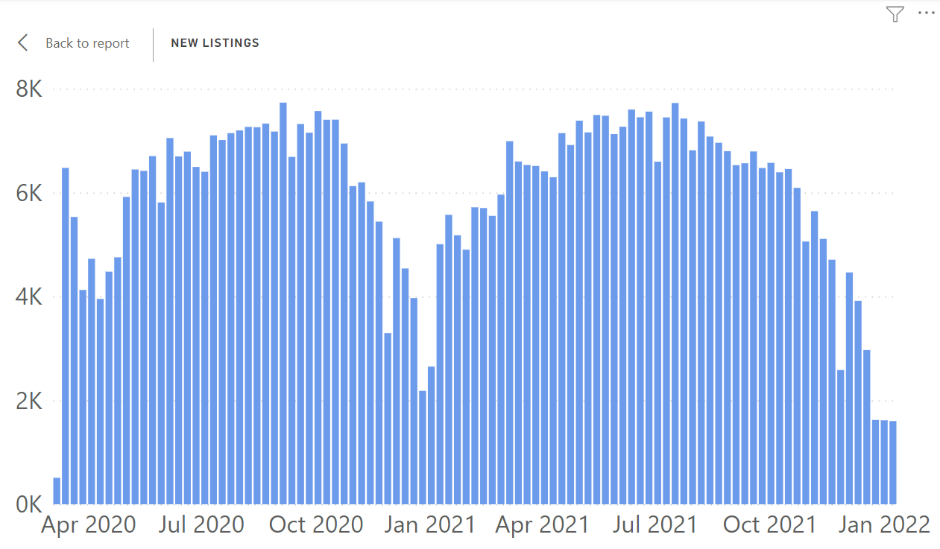
The COVID impact making situation worse again

Slide 15
From white hot, back to plain old boring red hot (not cool)
SERIES: Sales with sold price above asking price (Existing SFH)
SOURCE: CALIFORNIA ASSOCIATION OF REALTORS®

Slide 16
Median home price still near record highs
California, November 2021: $782,480, -2.0% MTM, +11.9% YTY
SERIES: Median Price of Existing Single Family Homes
SOURCE: CALIFORNIA ASSOCIATION OF REALTORS®

Slide 17
Demand & Supply
In Action

Slide 18
Bought Sooner!
2021 C.A.R. Consumer Survey, N= 956

Slide 19
Roots of the California housing crisis

Slide 20
Number of new housing units off by all measures…
HCD Estimate: 180,000

Slide 21
Story playing out almost identically here in San Diego

Slide 22
Look familiar? Again, almost identical story locally

Slide 23
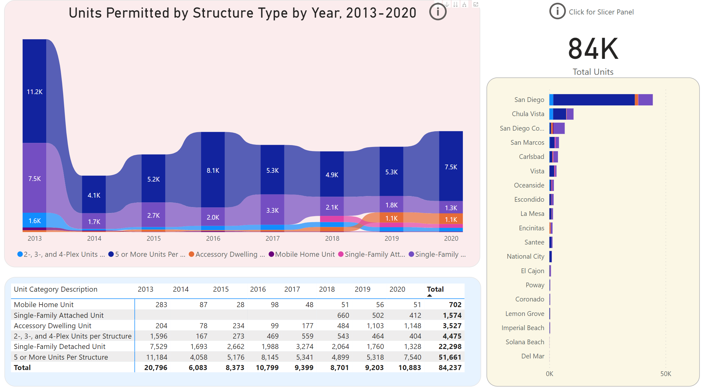

Slide 24
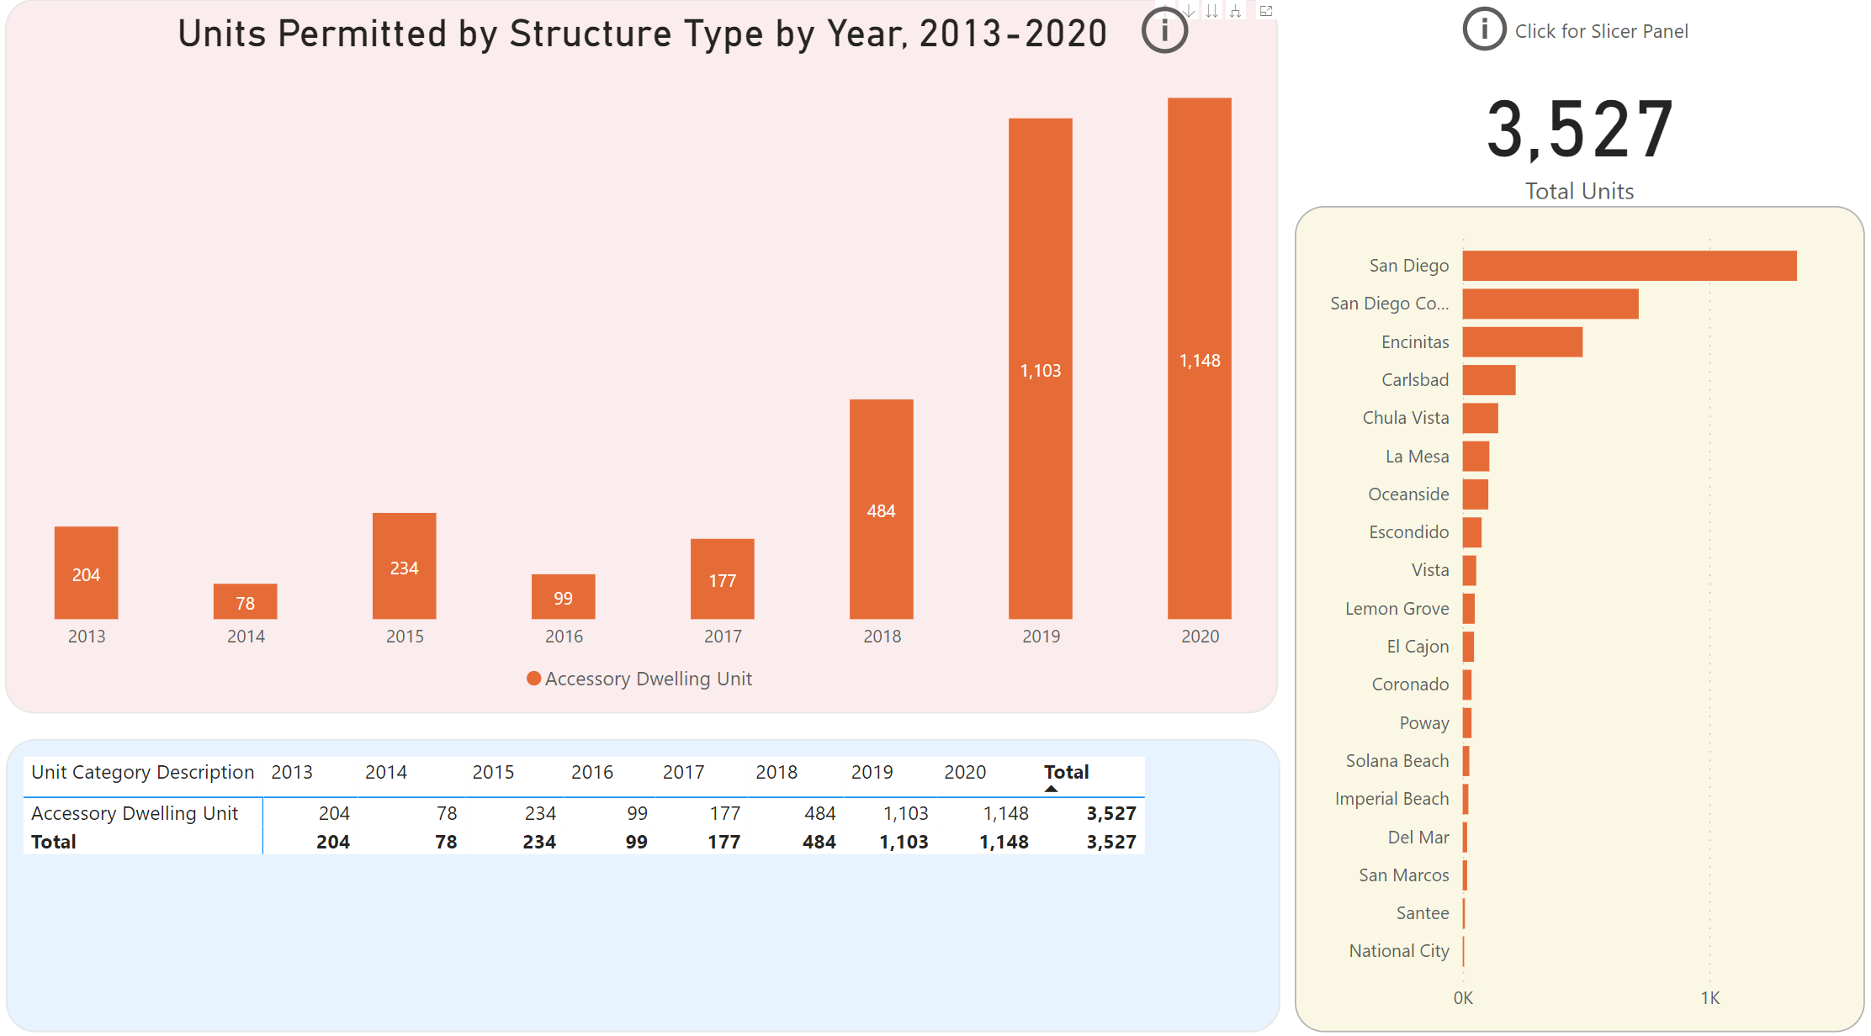

Slide 25
Consequences?

Slide 26
Bought Sooner!
2021 C.A.R. Consumer Survey, N= 956

Slide 27
Affordability deteriorating even with lower rates
California: 2006-2021
SERIES: Housing Affordability Index of Traditional Buyers
SOURCE: CALIFORNIA ASSOCIATION OF REALTORS®
Notes:
C.A.R. began producing its Housing Affordability Index (HAI) in 1984. At that time, fixed-rate mortgages were the prevailing form of financing a home purchase, while the calculations used to produce the HAI reflected a 20 percent down payment. The methodology also assumed a monthly payment for principal, interest, taxes and insurance that was no more than 30 percent of a household’s income. In the more than two decades since the CALIFORNIA ASSOCIATION OF REALTORS® first conceived the HAI, the mortgage finance landscape has changed dramatically. The range of mortgage products available to buyers as well as underwriting criteria has changed. C.A.R. developed the new index measuring affordability for first-time home buyers to better reflect the realities of today’s real estate market.

Slide 28
Supply exacerbates systemic issues present elsewhere

Slide 29
The need for housing is MORE urgent than ever
19%
Q. How was the property occupied?
SERIES: 2020 Housing Market Survey
SOURCE: CALIFORNIA ASSOCIATION OF REALTORS®

Slide 30
Rates have been rising recently

Slide 31
And even small changes in rates have a big impact

Slide 32
Time to Get
Serious on Supply

Slide 33
Stabilizing above pre-crisis levels, just not 15-year highs…
California, November 2021 Sales: 454,450 Units, +10.6% YTD, -10.7% YTY, +4.7% MTM
SERIES: Sales of Existing Single Family Homes
SOURCE: CALIFORNIA ASSOCIATION OF REALTORS®
Notes:
*Sales are seasonally adjusted and annualized

Slide 34
California economic outlook
 | 2016 | 2017 | 2018 | 2019 | 2020 | 2021p | 2022f
Nonfarm Job Growth | 2.3% | 2.1% | 2.1% | 1.5% | -6.9% | 2.0% | 4.6%
Unemployment | 5.5% | 4.8% | 4.3% | 4.1% | 10.3% | 7.8% | 5.8%
CA Population (Million) | 39.4 | 39.5 | 39.6 | 39.6 | 39.5 | 39.5 | 39.5
Population Growth | 0.6% | 0.4% | 0.2% | 0.1% | -0.5% | 0.0% | 0.1%
SERIES: U.S. Economic Outlook
SOURCE: CALIFORNIA ASSOCIATION OF REALTORS®

Slide 35
California housing market outlook
 | 2015 | 2016 | 2017 | 2018 | 2019 | 2020 | 2021p | 2022f
SFH Resales (000s) | 409.4 | 417.7 | 424.9 | 402.6 | 398.0 | 411.9 | 439.8 | 416.8
% Change | 7.0% | 2.0% | 1.7% | -5.2% | -1.2% | 3.5% | 6.8% | -5.2%
Median Price ($000s) | $476.3 | $502.3 | $537.9 | $569.5 | $592.4 | $659.4 | $793.1 | $834.4
% Change | 6.6% | 5.4% | 7.1% | 5.9% | 4.0% | 11.3% | 20.3% | 5.2%
Housing Affordability Index | 31% | 31% | 29% | 28% | 31% | 32% | 26% | 23%
30-Yr FRM | 3.9% | 3.6% | 4.0% | 4.5% | 3.9% | 3.1% | 3.0% | 3.5%
page
35
SERIES: CA Housing Market Outlook
SOURCE: CALIFORNIA ASSOCIATION OF REALTORS®

Slide 36
Many disparate external forces converging…
The Good News
The econ. tide is rising
Buyers want to buy (a lot)
Need us more than ever
Market still attractive for sellers
Rates will be favorable
Sales will stay solid next year
Home prices will keep rising
The Bad News
We still don’t build enough
COVID made problems worse
Big challenges for FTBs/ownership
Small rate changes hurt a lot
Big challenges for the economy
Need “all of the above” solution
Rising tide lifting some boats

Slide 37
Thank You
This presentation can be found on
www.car.org/marketdata
Speeches & Presentations
jordanl@car.org

