Slide 1
California Housing
Market Update
Greater San Diego
Association of REALTORS®
August 19, 2020
Jordan G. Levine
Deputy Chief Economist
California Association of REALTORS®

Slide 2
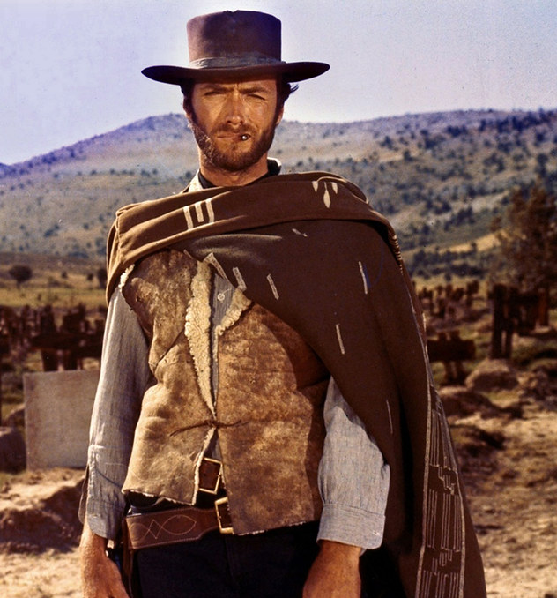
The good, bad, and ugly of California’s recovery
The Good
Significant progress on market & economy
Lots of demand from homebuyers
Rearview indicators are strong
The Bad
Lack of supply impeding recovery
Can’t seem to get virus behind us
Closed sales already dipping
The Ugly
Forward-looking indicators flagging
Lots of economic uncertainty remains

Slide 3
What Does the
Rear View Mirror Say?

Slide 4
California housing market: sales up, price set new record, supply lowest in years
July 2020
+6.4% YTY
Existing Home Sales
% change
+28.8% MTM
Price
$666,320
+9.6% Y2Y
Unsold Inventory Index
2.1 months
-34.4% Y2Y
Median Days on Market
17 days
-19.0% Y2Y
Sales Price to List Price Ratio
100.0%
+1.0% Y2Y
CALIFORNIA ASSOCIATION OF REALTORS®

Slide 5
San Diego experienced a similar bump

Slide 6
How About
The Here & Now?

Slide 7
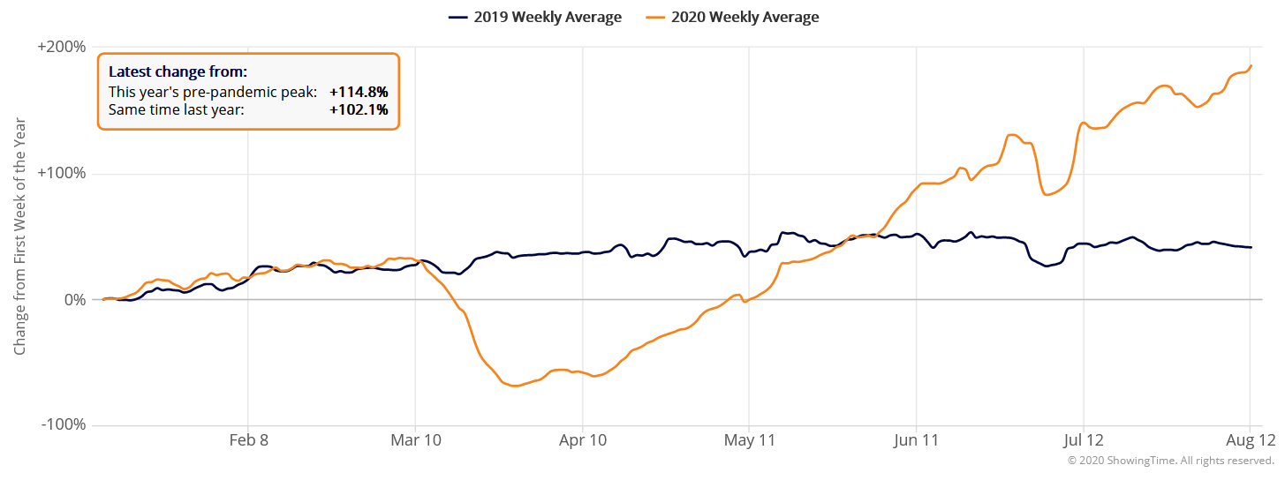
Showings in California continue to outpace last year’s
SERIES: Weekly showings normalized to the first calendar week of January, 7-day moving average
SOURCE: Showingtime.com,
Notes:
7
The data points represent a rolling weekly average in ShowingTime’s 100 top markets, with each market recording tens of thousands of appointments in 2019 and 2020.
ShowingTime is the leading market stats and showing management technology provider to the residential real estate industry.

Slide 8
Purchase applications still up from last year by over 20%

Slide 9
New listings lowest in six weeks
Notes:
New listings include existing single-family homes only

Slide 10
Pending sales continued to moderate
Notes:
Pending sales include existing single-family homes only

Slide 11
Closed sales lowest since late June
**Closed sales for the latest week will likely be revised upward due to recording delays.
Notes:
Closed sales include existing single-family homes only

Slide 12
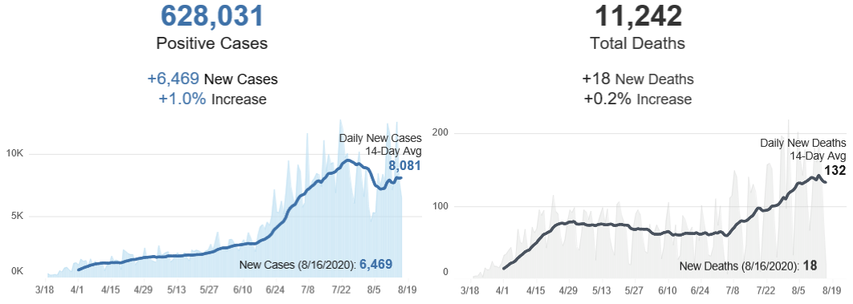
COVID cases and deaths improved, but remain high

Slide 13
More than 15 million still on the dole
SOURCE: U.S. Dept. of Labor
Notes:
https://www.dol.gov/ui/data.pdf

Slide 14
Still lots of pain here in California

Slide 15
Concluding remarks
Yes, things have gotten better
Sales improving to pre-crisis levels
Macroeconomic data has also improved
No, it is way too early to celebrate
Back to our age-old problem of inventory
COVID crisis lingers on and impedes recovery
Keeping it really real
Deep damage done with multiplier effects yet to hit
Lots of healing left to do even as things improve
We can be cautiously optimistic, emphasis on cautiously!

Slide 16
Thank You
This presentation can be found on
www.car.org/marketdata
Speeches & Presentations
jordanl@car.org

